Slide 1
Financial Accounting (FI)
Curriculum: Introduction to S/4HANA using Global Bike

Slide 2

4.3 (July 2025)
S/4HANA 2023
Fiori 3.0
Global Bike
No Prerequisites needed

Slide 3
Bret Wagner
Stefan Weidner
Babett Ruß
Beginner

Slide 4
You are able to
define the central organizational structures of the FI module.
summarize the master data which is most important for the FI module.
explain a standard financial accounting process.
outline the basic functionalities of FI reporting.
recognize some of integration points to other SAP modules.

Slide 5
Agenda
FI Organizational Structure
FI Master Data
FI Processes
FI Reporting

Slide 6
Goal of Financial Accounting (FI)
Financial Accounting is designed to collect the transactional data that provides a foundation for preparing the standard portfolio of reports.
In general, these reports are primarily, but not exclusively, directed at external parties.
Standard reports include:
  Balance Sheet
  Income Statement
  Statement of Cash Flows

Slide 7
Target Groups
Internal
  Executives
  Senior Management
  Administrative Staff
  Employees
External
  Legal Authorities
  Banks
  Auditors
  Shareholders
  Insurance
  Taxing Authorities
  Media
  Financial Analysts

Slide 8
FI Organizational Structure
Represents the legal and/or organizational view of a company
Forms a framework that supports a company's financial decisions using the methods desired by management
Allows the accurate and organized collection of business information
Supports the development and presentation of relevant information to enable and support business decisions

Slide 9

FI Organizational Structure
Client
  An independent environment in the system
Company Code
  Represents an independent legal accounting unit
  Balanced set of books, as required by law, are prepared at this level.
  A client may have more than one company code
    United States
    Germany
    United Kingdom
    Australia
    …
Assets
Liabilities &
Owners Equity

Slide 10
FI Organizational Structure
Chart of Accounts
  A classification scheme consisting of a group of general ledger (G/L) accounts
  Provides a framework for the recording of values to ensure an orderly rendering of accounting data
  The G/L accounts it contains are used by one or more company codes.
Credit Control Area
  An organizational entity which grants and monitors a credit limit for customers.
  It can include one or more company codes
Business Area
  An organizational unit that represents a separate area of operations or responsibilities within an organization and to which value changes recorded in Financial Accounting can be allocated
  Financial statements can be created for business areas, and these statements can be used for various internal reporting purposes.

Slide 11
Global Bike Structure for Financial Accounting
Global Bike
Client
Global Bike Inc.
Global Bike Germany GmbH
Company
Code
Global Bike
Chart of Accounts
Chart of
Accounts
Bikes
Business Area
Global Credit Control
Credit Control
Area

Slide 12
Global Bike Enterprise Structure in SAP ERP (Accounting)
Business Area – Bikes BI00
CC CA00
CC GB00
CC AU00
CC JP00
CC US00
CC DE00
Company
Code
Chart of Accounts (global) GL00
Credit Control Area (global) GL00
CA North Am. NA00
CA Europe EU00
CA Asia AS00
Controlling Area
(see Controlling unit)
Operating Concern (global) GL00
Operating Concern
(see Controlling unit)
Client Global Bike
Notes:
Organizational units displayed in grey are not yet implemented, but are already planned in Global Bike.

Slide 13
Agenda
FI Organizational Structure
FI Master Data
FI Processes
FI Reporting

Slide 14
FI Master Data
General Ledger (G/L) Accounts
  The unique combination of Company Code and Chart of Account creates a data storage area called a General Ledger.
  The General Ledger contains a listing of the transactions effecting each account in the Chart of Accounts and the respective account balance.
  It is utilized in the preparation of financial accounting statements.
Customer and Vendor Master Data
  Customer and vendor account balances are maintained in FI through fully integrated accounts receivable and accounts payable sub-ledgers.
  Financial postings for customers and vendors are made directly to their respective individual accounts and accompanied by a concurrent automatic posting to the General Ledger.

Slide 15
Customer Accounts
Accounts Receivable Sub-Ledger (FI-AR)
  Information with respect to customers who purchase the enterprise’s goods and services such as sales and payments made
  Substantive and important integration between Sales and Distribution (SD) and Financial Accounting (FI)
  Billings in SD generate FI journal entries for sales activity
Customer 189
Customer 142
Accounts Receivable
(General Ledger)
100
300
950
Customer 135
Customer 123
400
150

Slide 16
Vendor Accounts
Accounts Payable Subledger (FI-AP)
  Information with respect to Vendors from whom the enterprise purchases goods and services such as purchases and payments made
  Substantive and important integration between Materials Management (MM) and Financial Accounting (FI)
  Purchase and goods receipt activities in MM generate FI journal entries
Vendor 100234
Vendor 100435
Accounts Payable
(General Ledger)
200
250
850
Vendor 100621
Vendor 100846
100
300

Slide 17
Agenda
FI Organizational Structure
FI Master Data
FI Processes
FI Reporting

Slide 18
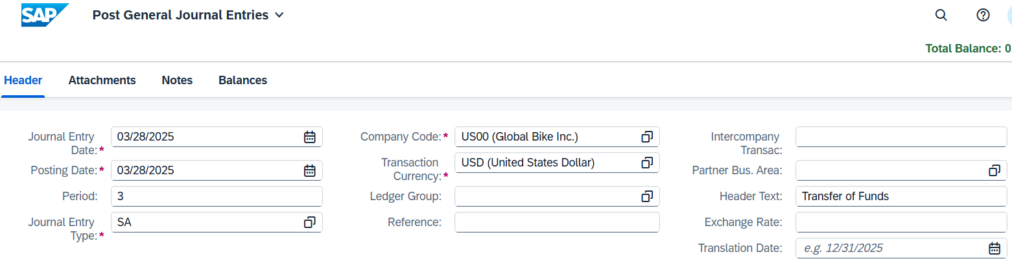

FI Processes
Posting a G/L Entry

Slide 19
Agenda
FI Organizational Structure
FI Master Data
FI Processes
FI Reporting

Slide 20
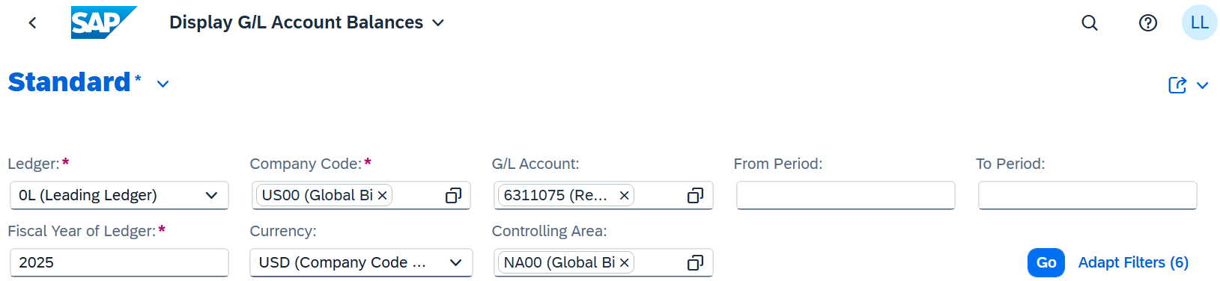
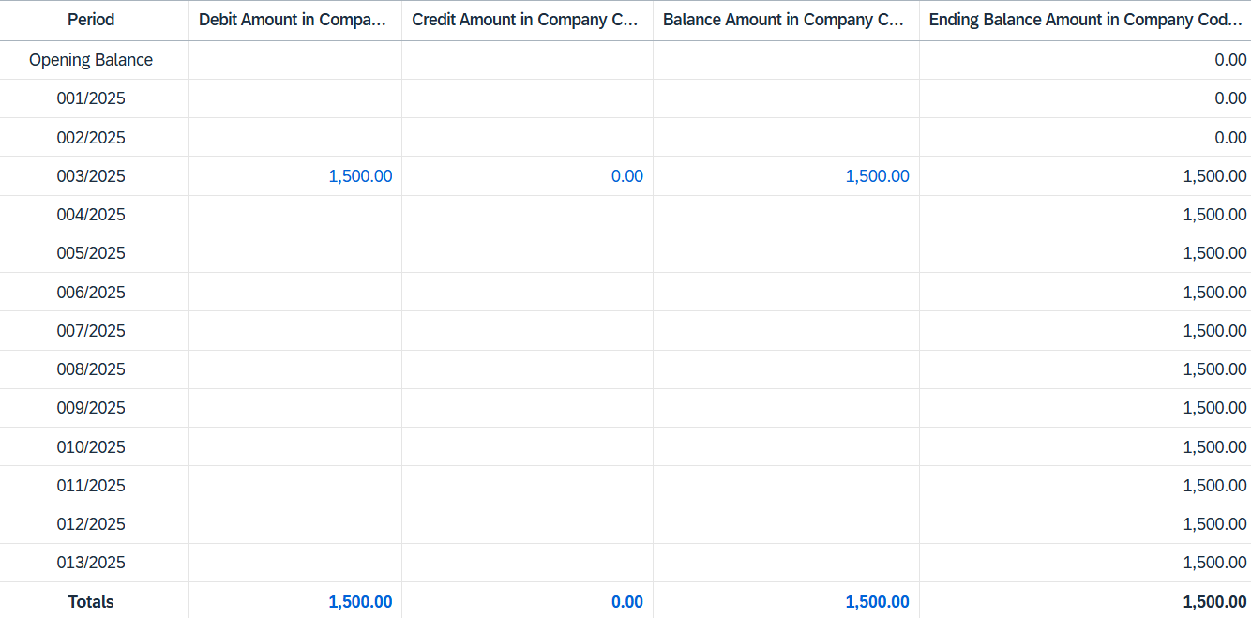
FI Reporting
G/L Account Summary

Slide 21
FI Reporting
Balance Sheet
  Presentation of an organization’s Assets, Liabilities, and Equity at a point in time
  Assets: What the company owns
  Liabilities: What the company owes
  Equity: The difference between Assets and Liabilities
  Assets = Liabilities + Equity

Slide 22
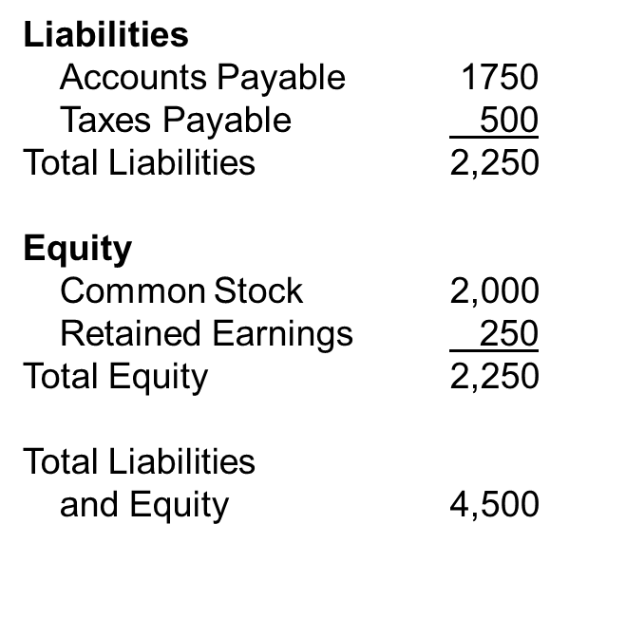
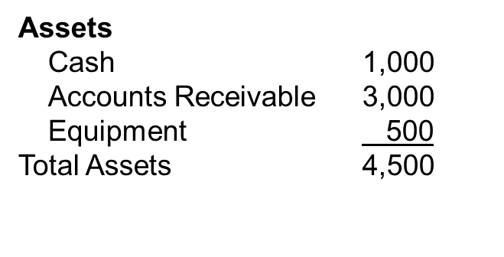
FI Reporting
Balance Sheet Example

Slide 23
FI Reporting
Income Statement
  Presentation of an organization’s revenues and expenses for a given period of time (e.g. monthly, quarterly, or yearly)
  Revenues, in a simple sense, are inflows of cash as a result of selling activities or the disposal of company assets.
  Expenses, in a simple sense, are outflows of cash or the creation of liabilities to support company operations.
  Revenues - Expenses = Net Income

Slide 24
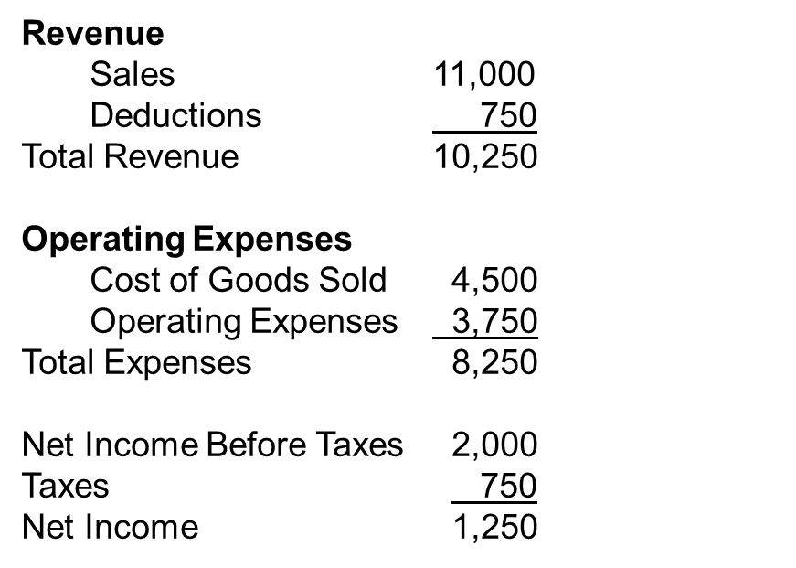
FI Reporting
Income Statement Example

Slide 25

FI Reporting
Statement of Cash Flows
  Considers the associated changes, both inflows and outflows, that have occurred in cash – arguably the most important of all assets – over a given period of time (e.g. monthly, quarterly, or annually)

Slide 26
Accountants and Audit Trails
Audit trails allow an auditor to begin with an account balance on a financial statement and trace through the accounting records to the transactions that support the account balance.
Audit trails enable an auditor to trace individual transactions to the effected account balance(s) on a financial statement.

Slide 27
SAP Document Principle
Each business transaction impacting FI writes data to the SAP database creating a uniquely numbered electronic document.
The document number can be used to recall the transaction at a later date.
It contains, for example, such critical and necessary information as:
  Responsible person
  Date and time of the transaction
  Commercial content
Once written to the SAP database, a financial document (one impacting the financial position of the company) can not be deleted from the database.
It can be changed to some degree.
The SAP document principle provides a solid and important framework for a strong internal control system – a requirement of law for companies that operate in most countries in the world.

Slide 28
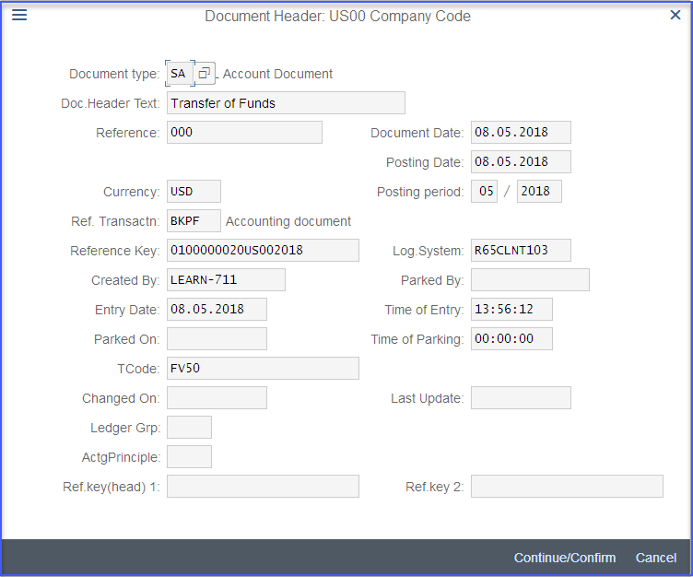
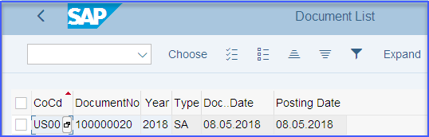
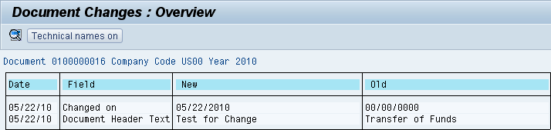
SAP Document Principle

Slide 29
SAP FI Module
Fully integrated with other SAP modules including, but not limited to:
  Sales and Distribution (SD)
  Materials Management (MM)
  Production Planning and Execution (PP)
  Managerial Accounting (CO)

